Slide 1

Needfinding
MED.AI
MEDICAL APP
NGUYEN DINH THUAN
NGUYEN DUC PHUC HOANG
ADINA WAIDHAS
22.10.2024

Slide 2
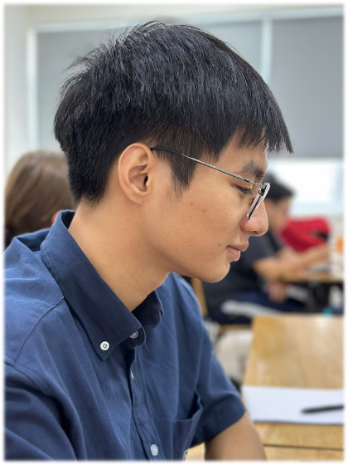
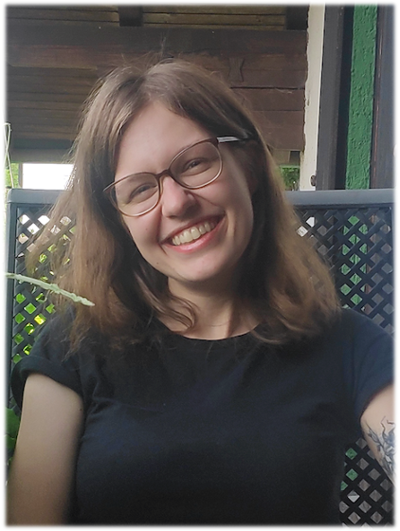

Introduction Team Members
Nguyen Dinh Thuan
(20210827)
Adina Waidhas
(2024T0035)
Nguyen Duc Phuc Hoang
(20210385)

Slide 3
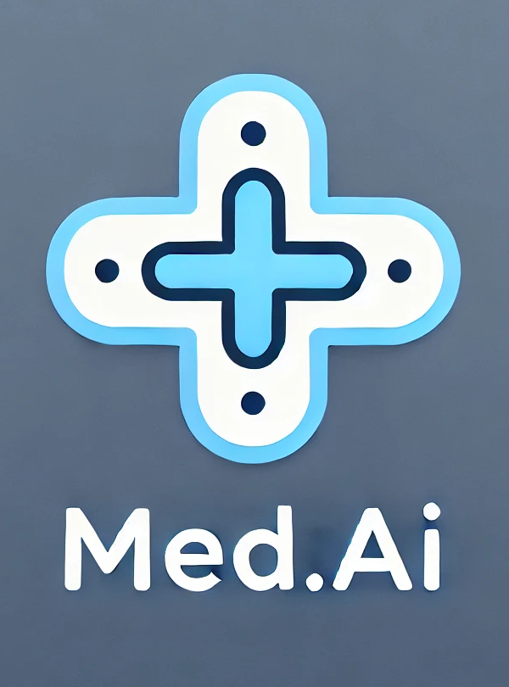
Introduction Problem Domain
Medical Website Usability, including navigation, scheduling, information, chatbot
Investigate user experiences on medical websites to identify pain points and improvement
Focus on how different user groups interact with the platform

Slide 4
Needfinding Methodology Our Interviewees
Who ?
- Normal user: Individual with typical experience with medical website
- Expert user: Medical professional
- Extreme user: Inexperienced older people
Why ?
Goal: To gather insights on how different user types interact with medical websites.
When ?
- Schedule at times convenient for the participants, each interview lasts 10-20 min
Where ?
- Online: Teams, Discord
- Face to face
How ?
15-20 minutes interview
Questionaire for more structured data

Slide 5


Needfinding Methodology Questions
What is your overall experience using medical websites?
How often do you visit medical websites, and what motivates your visit?
What frustrates you the most when using medical websites?
What improvements would you like to see on medical websites?
How do you feel about interacting with chatbots or automated systems on medical websites?
Have you ever had to contact customer support while using a medical website?
Have you ever had a security or privacy concern when using a medical website?
How often do you rely on medical websites versus calling the healthcare provider directly?
Do you prefer using apps over websites for managing your health information?
How do you navigate these websites on mobile versus desktop devices?

Slide 6
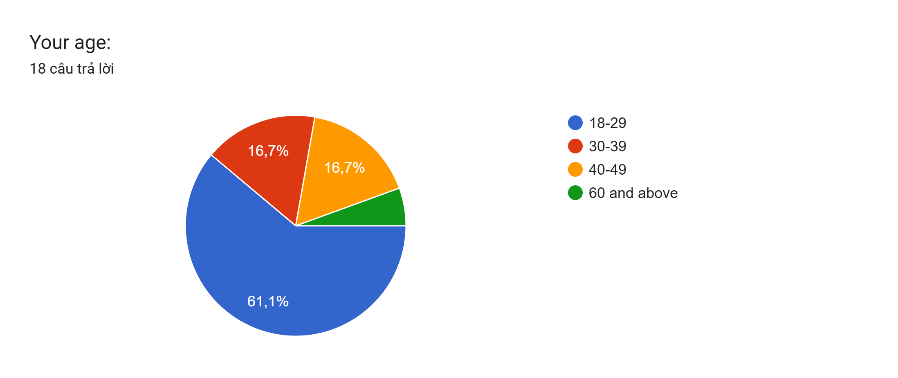
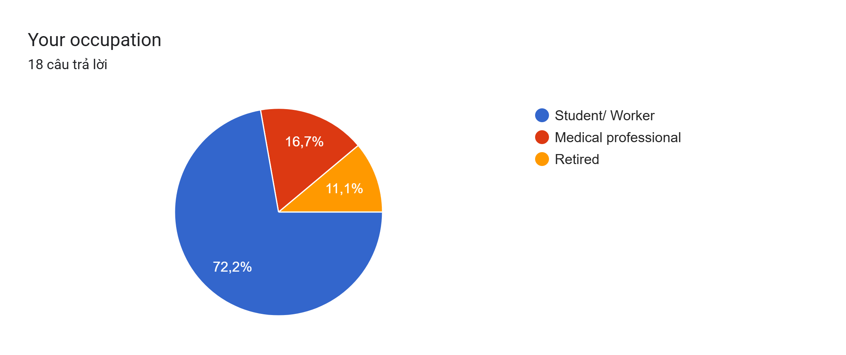
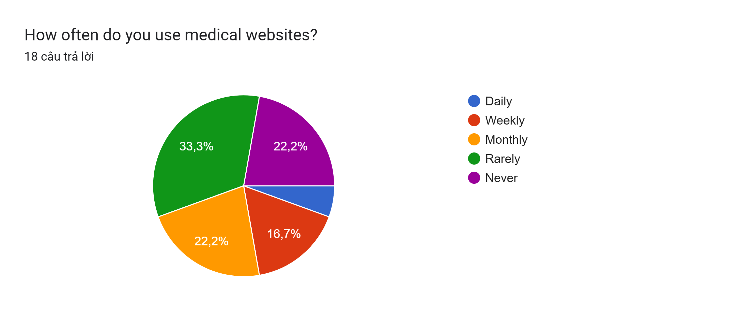
Interview/ Observation results
Interview: We interviewed 5 people:
Common users: Thanh (21, Student), Nghia (17, Student), Roman (32, Worker)
Extreme users: Trung (64, Retired)
Expert users: Ngan Ha (29, Specialist Doctor)
Questionaire: We received 18 responses from different user groups

Slide 7
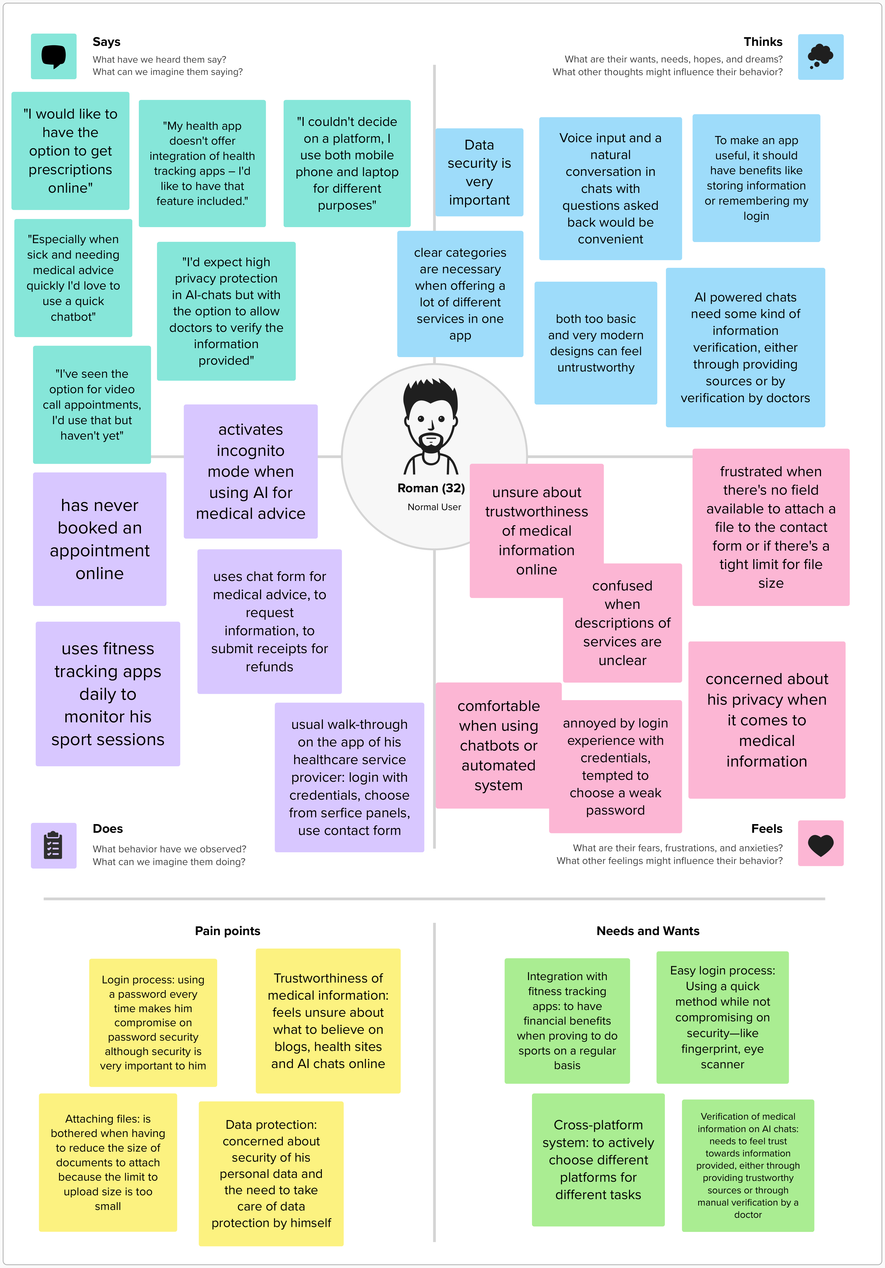
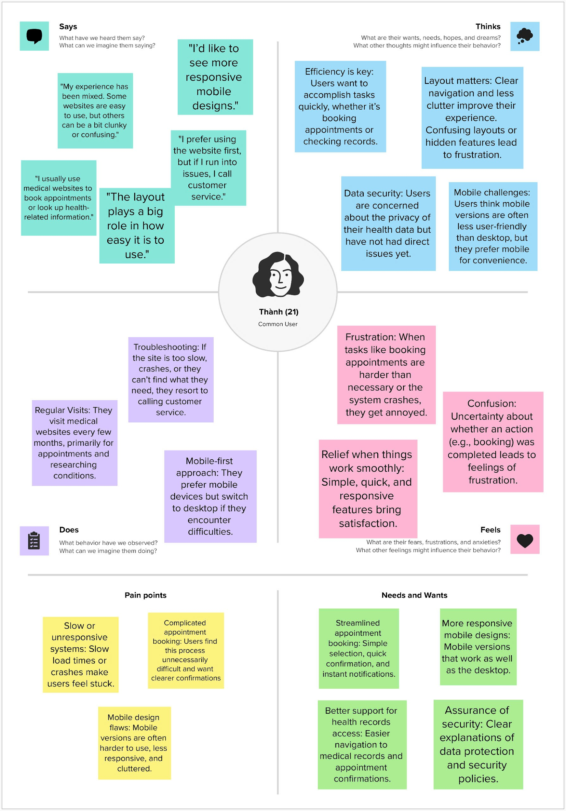
Interview/ Observation results Common User Empathy Map

Slide 8
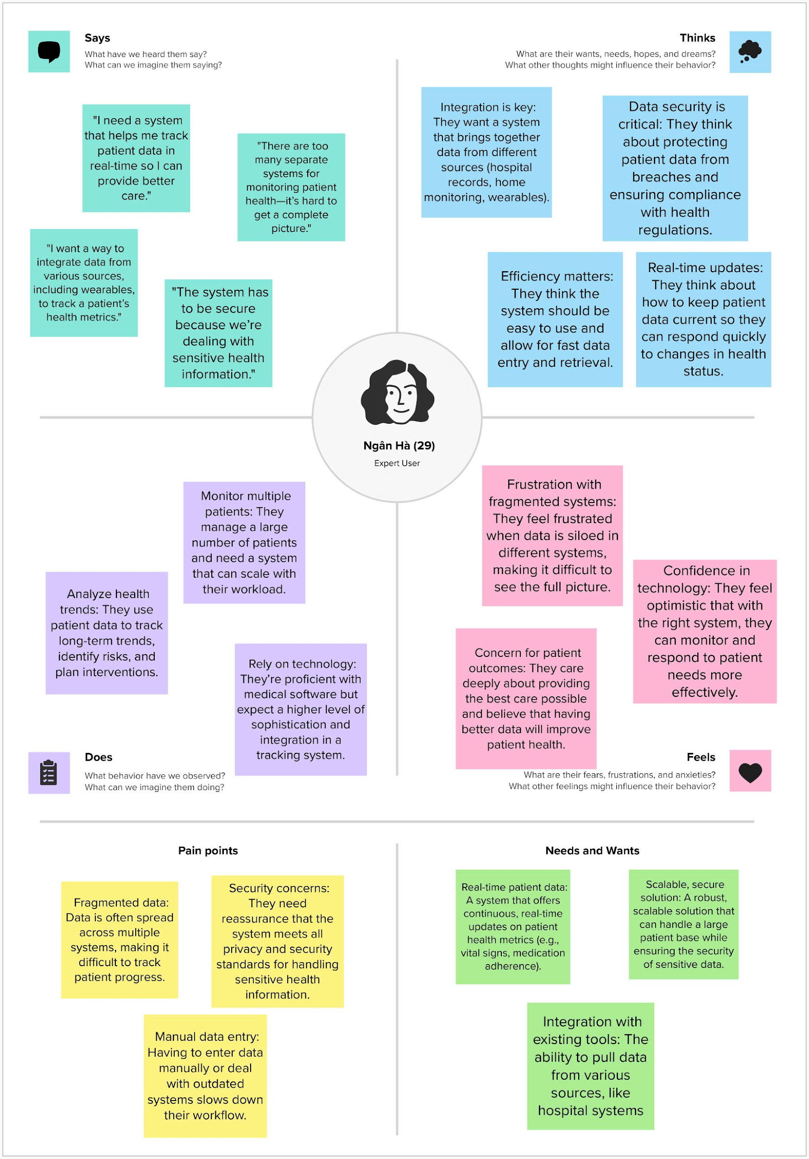
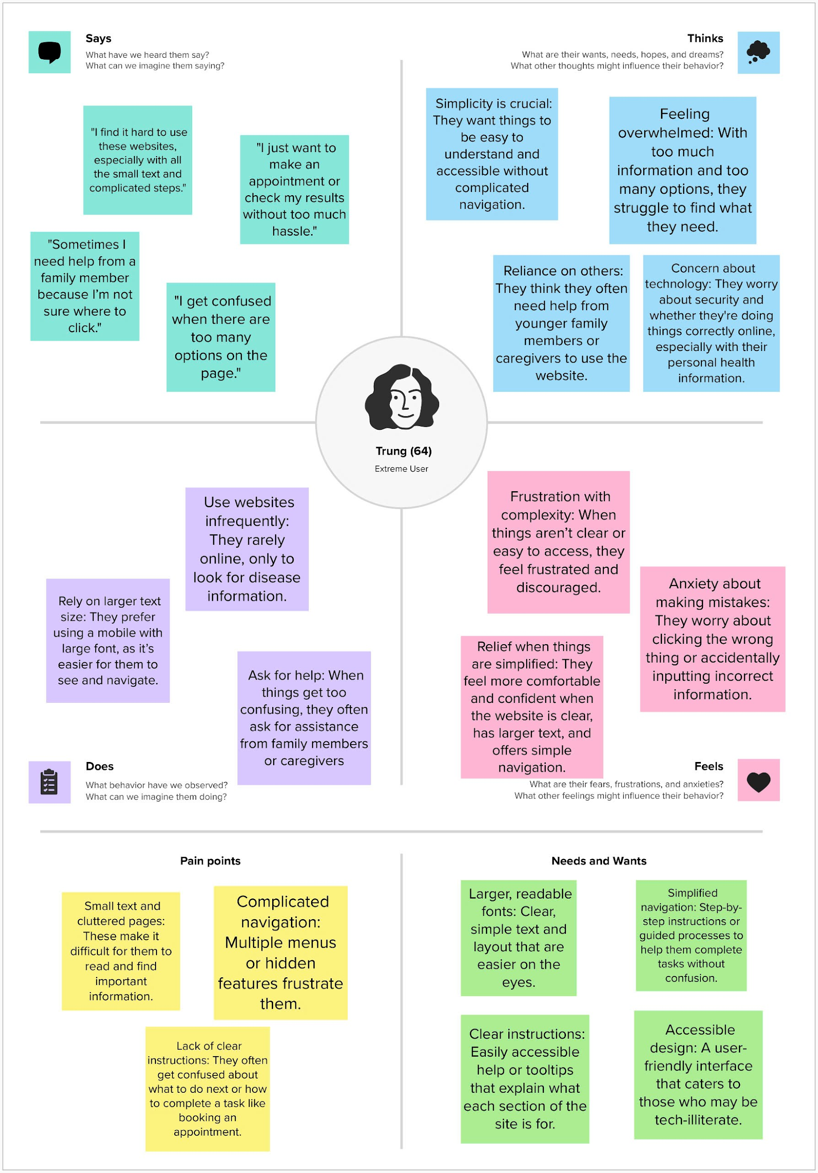
Interview/ Observation results Extreme and Expert User Empathy Map

Slide 9
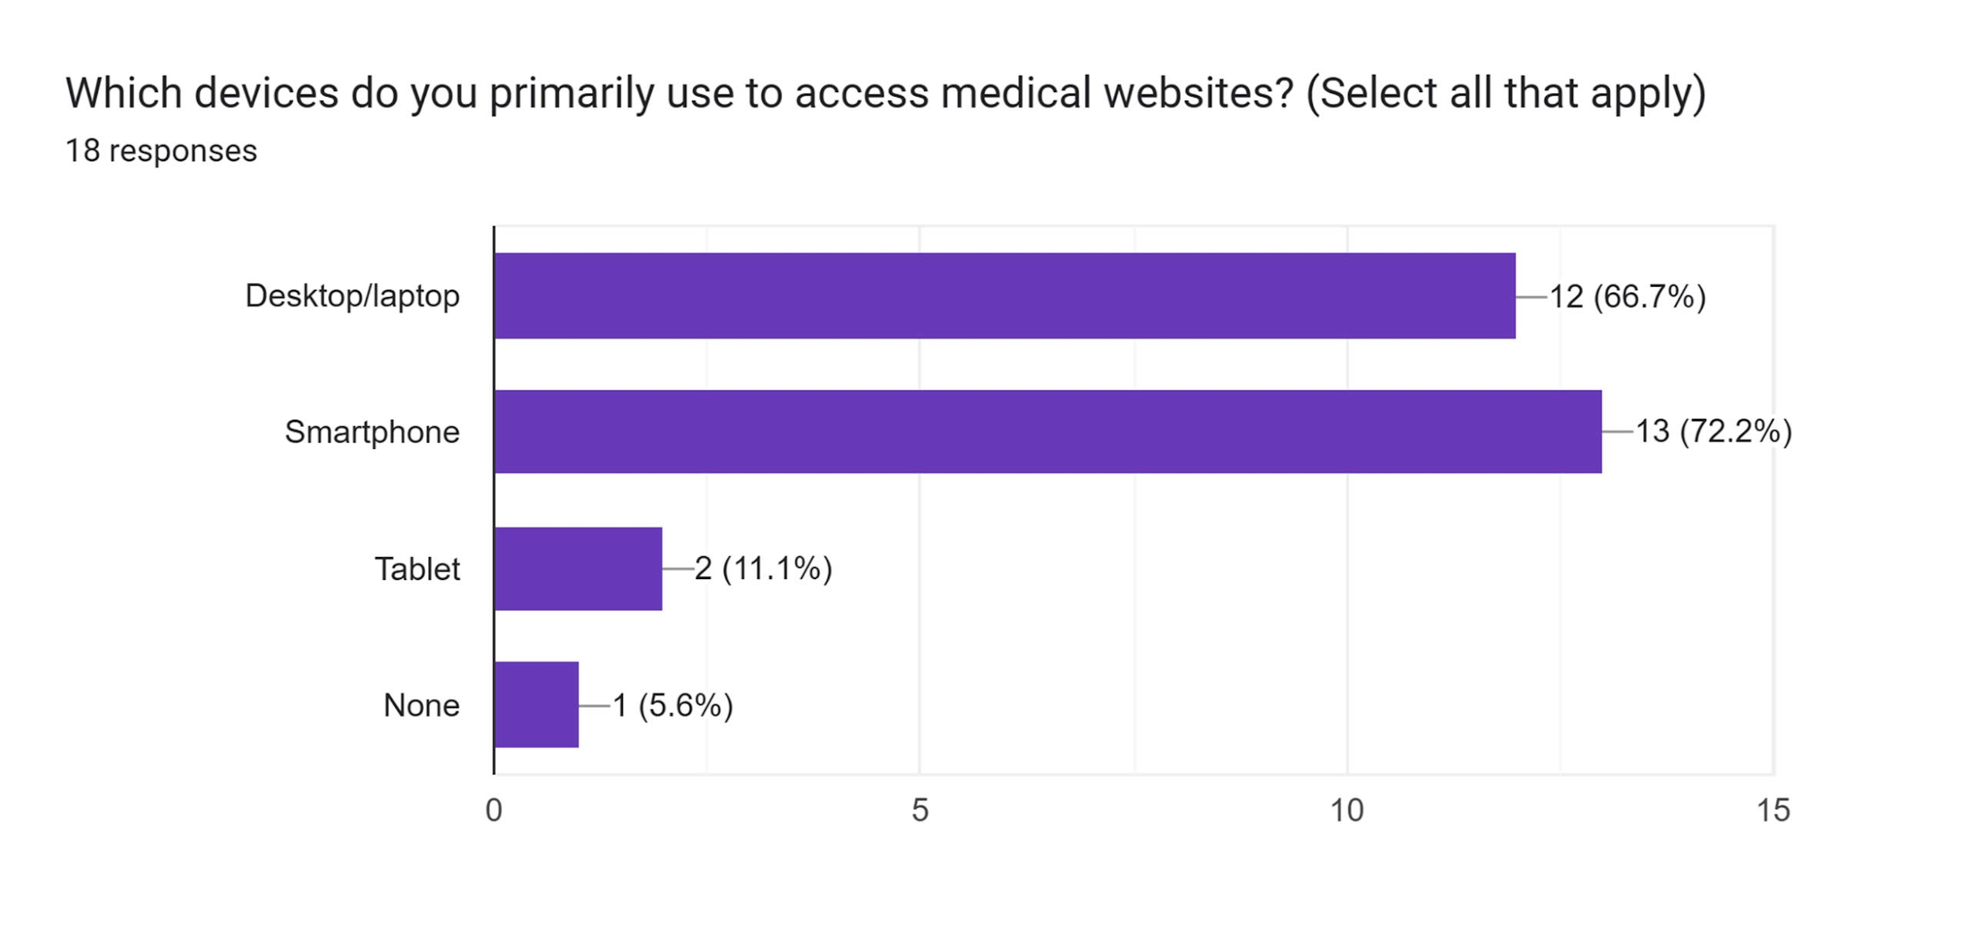
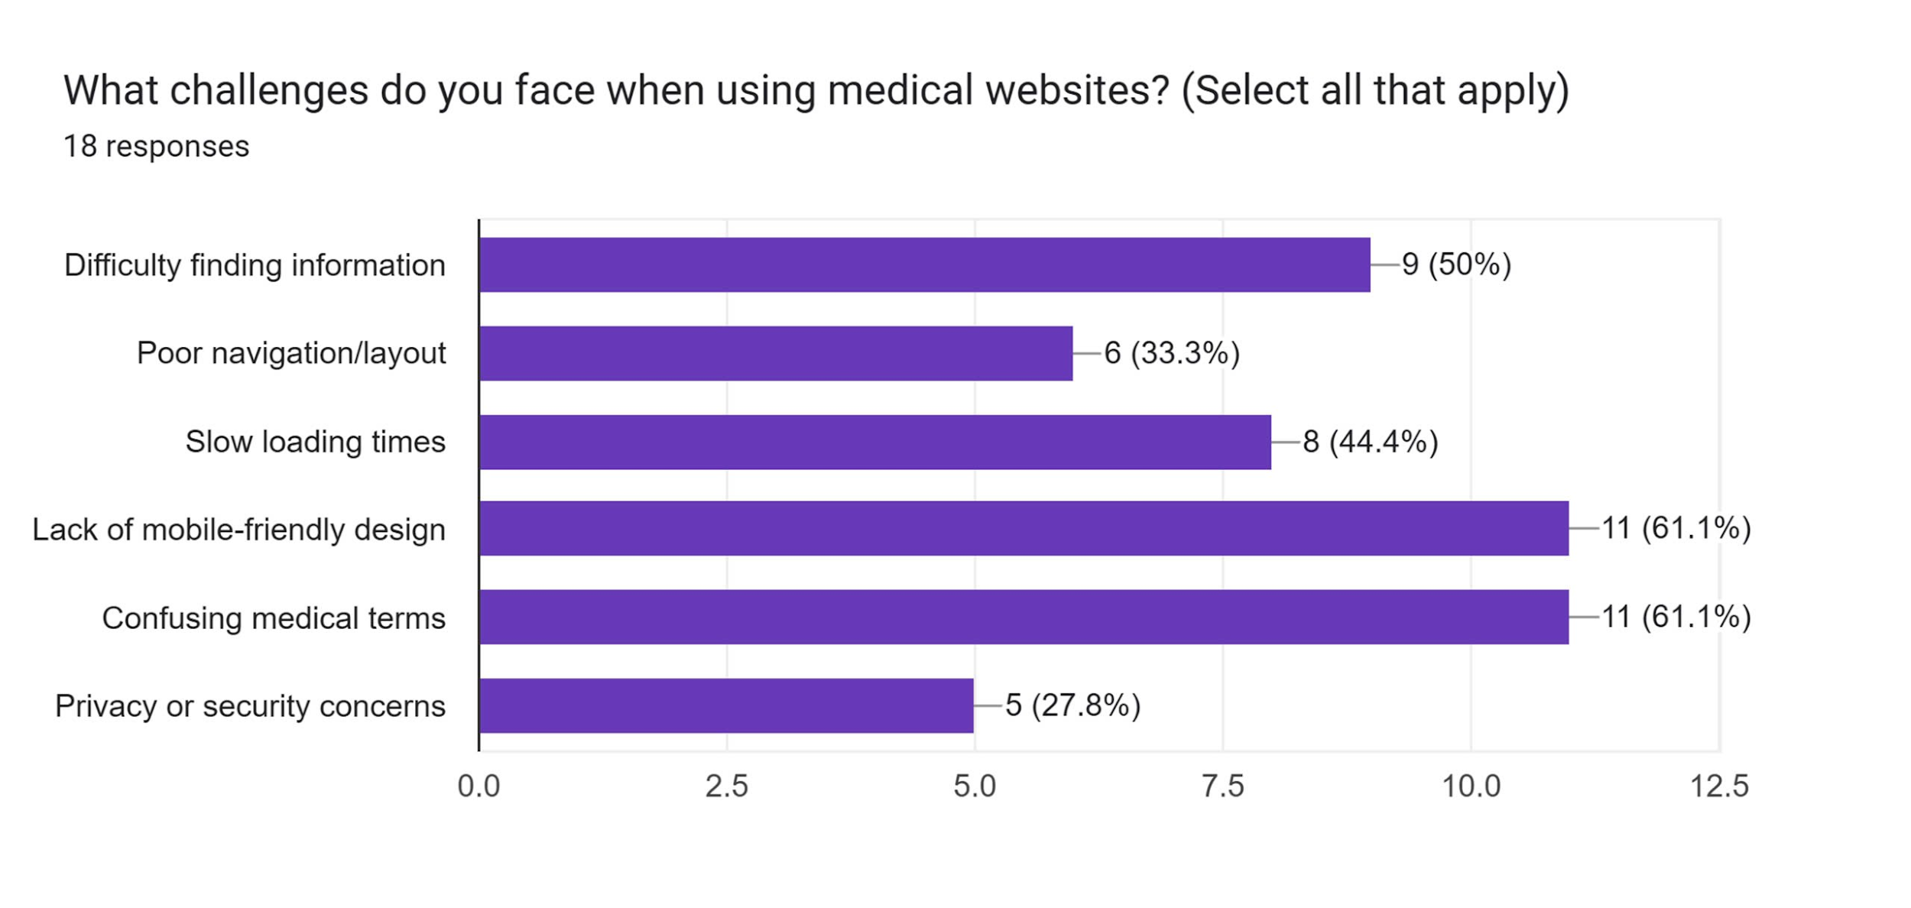
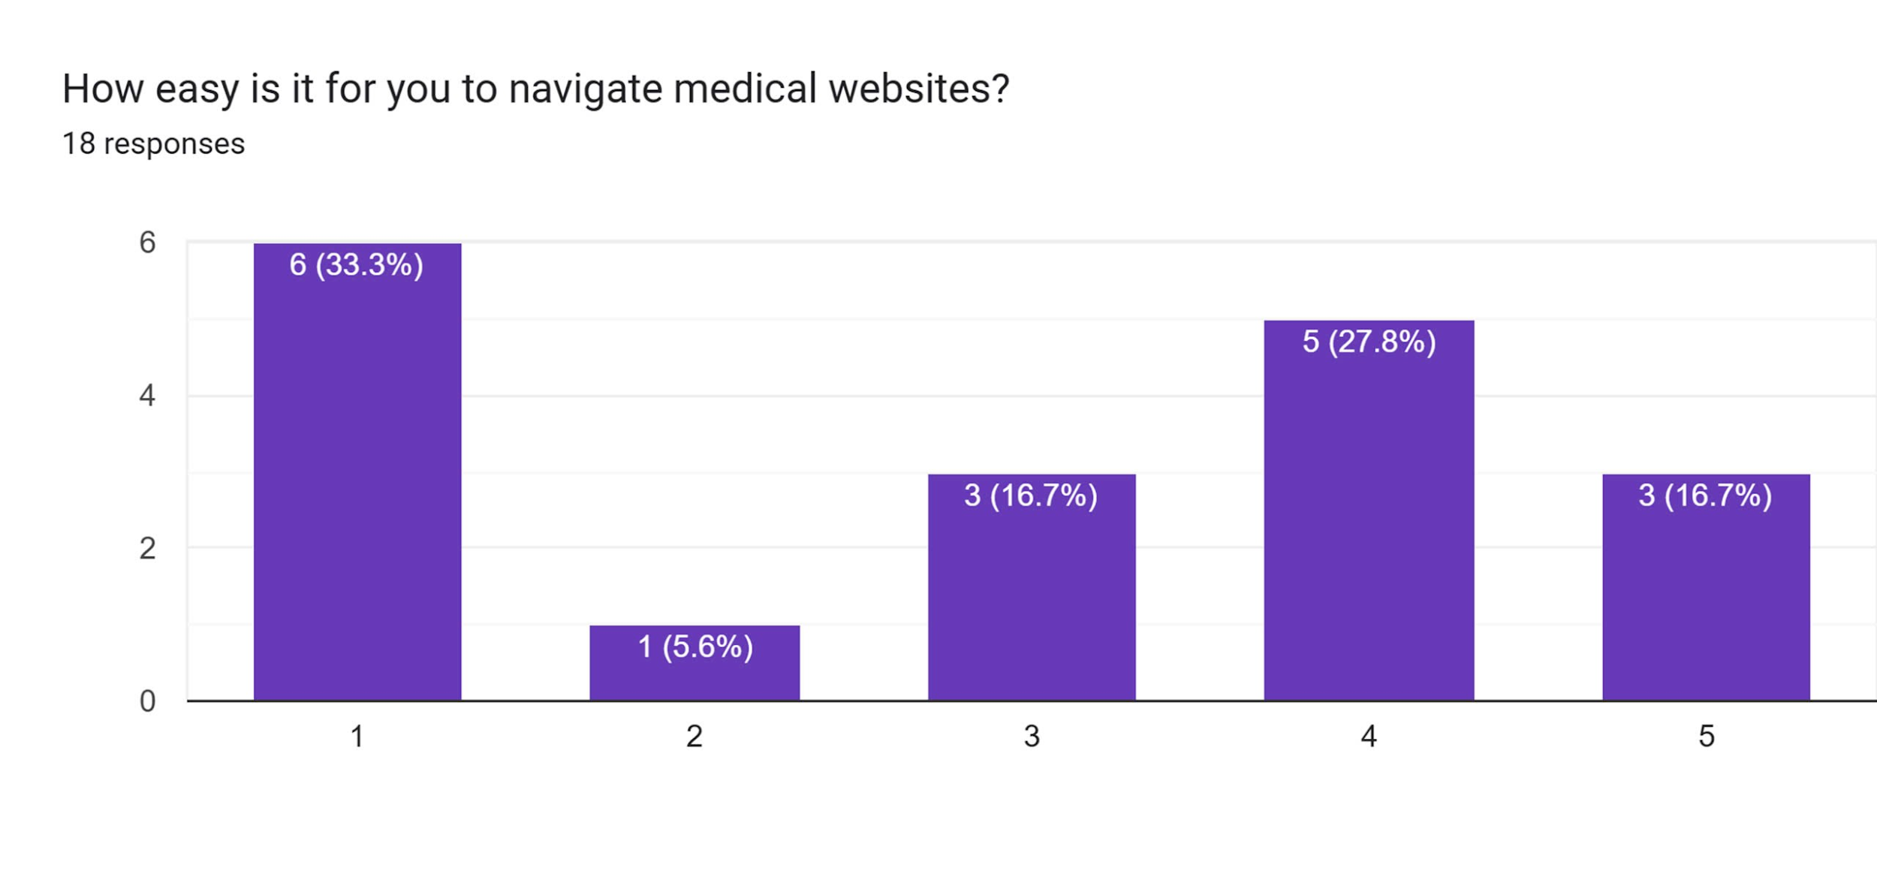
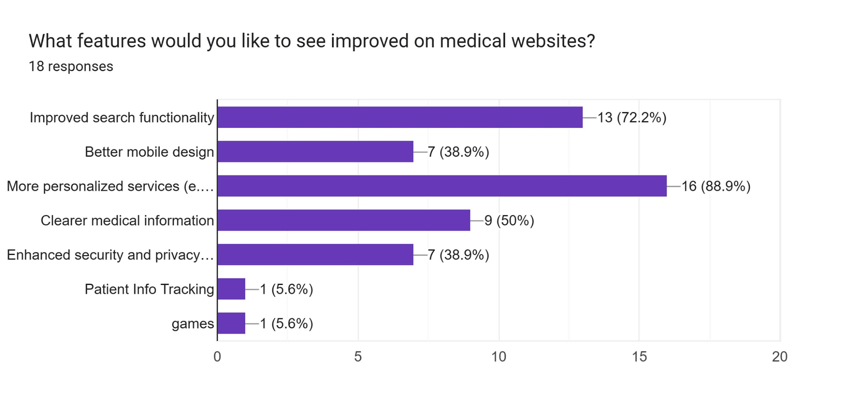
Interview/ Observation results Questionaire

Slide 10
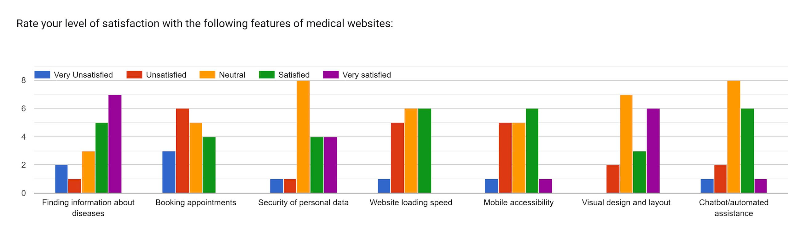
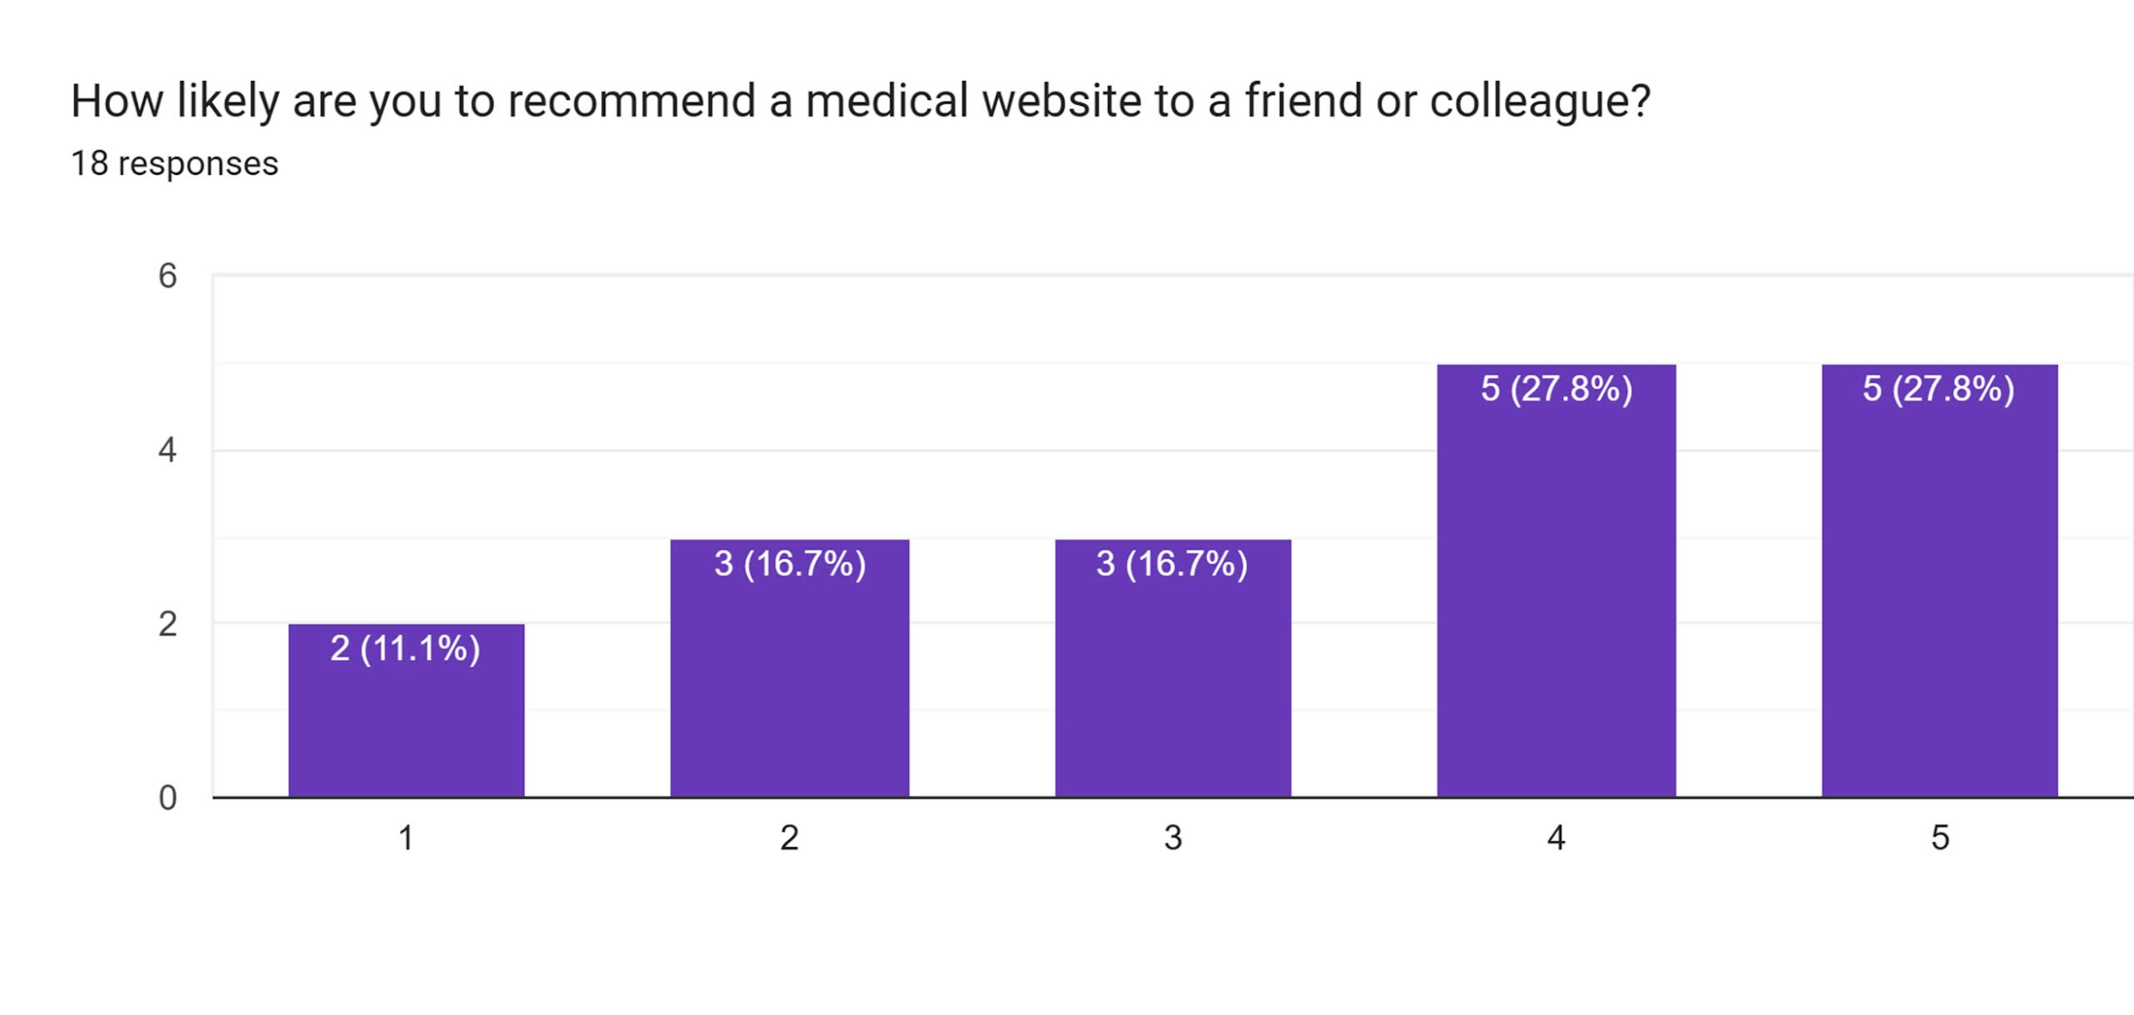
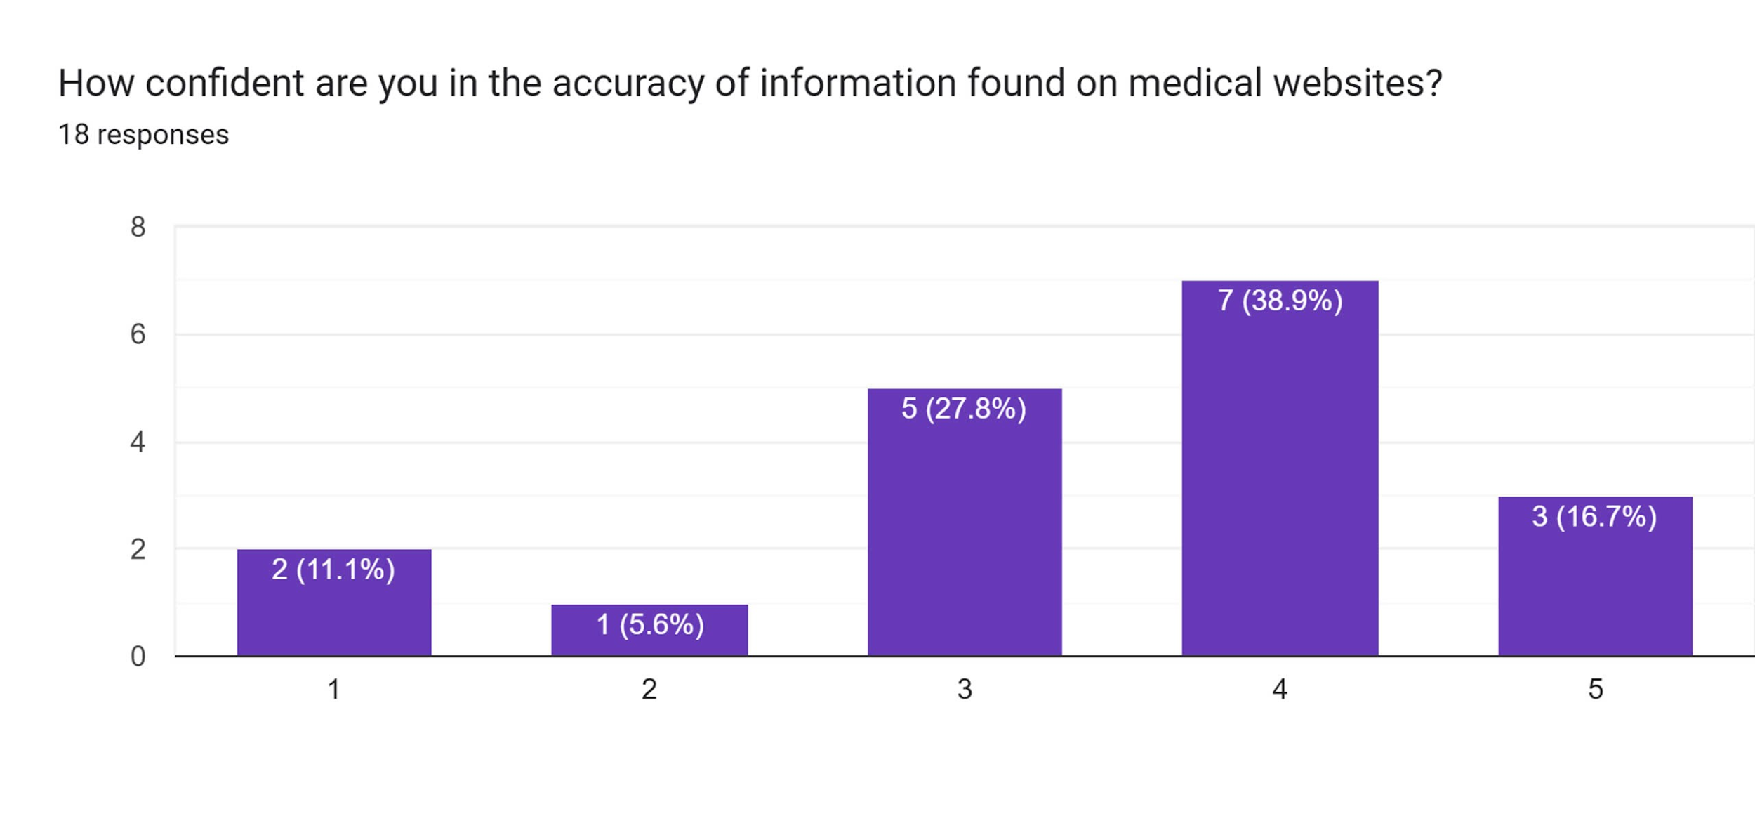
Interview/ Observation results Questionaire

Slide 11
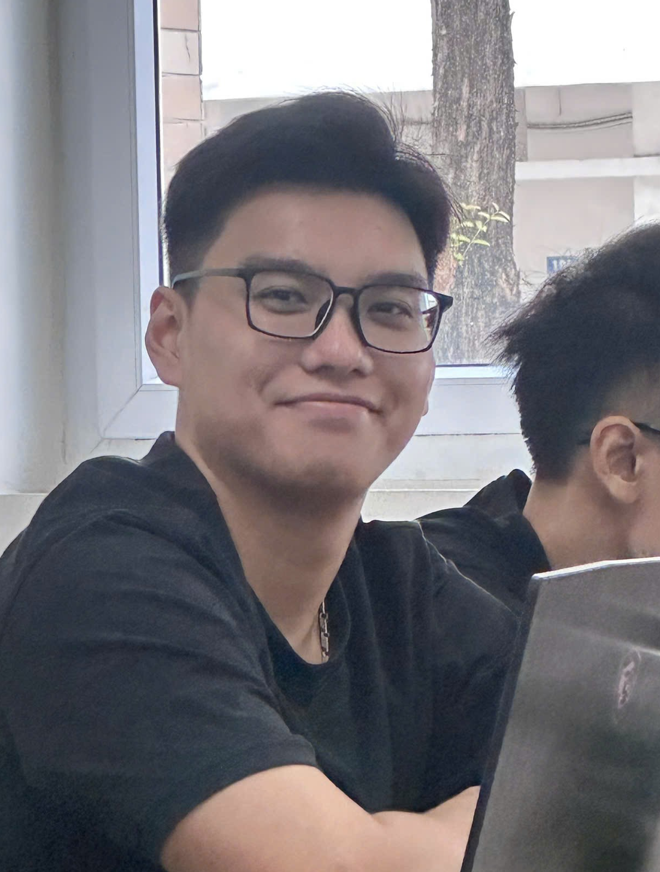


Analysis
“I don't usually use these sites for tracking my health, just for booking or research."
“I prefer using my phone for this, but the desktop version is easier to navigate. "
“ I need a system that helps me track patient data in real-time so I can provide better care."

Slide 12
Tensions, Contradictions
Automation vs. Human Support:
Users appreciated automated systems for booking and managing health, but when those systems failed, they felt abandoned and frustrated. Some express scepticism about trustworthiness of automated systems.
Convenience vs. Complexity:
Normal users, particularly on mobile, usually want fast, easy access, but often find the interface too cluttered. This reflects a tension between providing more features like integrating health tracking apps vs. streamlining the design.
Independence vs. Dependence:
Older adults desire independence in managing their health but frequently end up relying on others due to accessibility challenges. Tech-savvy users seek control over the security of their personal data.

Slide 13
Surprises
Preference for Simplicity Over Features:
Users, especially older ones, often preferred fewer options that were easier to navigate.
Mobile Frustrations for Older Users:
Older users found mobile navigation more frustrating compared to desktop, mainly due to small text and clutter.
Medical Experts Want More Automation:
Medical experts were more focused on automating patient monitoring and integrating data.

Slide 14
Conclusions & Questions
Simplicity and Accessibility Are Key:
Across all user groups, the most common demand was for simpler, more accessible designs. This indicates that current systems might be over-engineered for certain user groups, especially older adults. Simplification could improve the user experience for all.
Mobile Optimization Needs Work:
While mobile devices are increasingly used, they are not as optimized as desktop versions. This is particularly problematic for older adults, indicating a need for better mobile design and accessibility features like larger text and less clutter.
Integration vs. Simplicity:
For medical professionals, the challenge is integrating complex data without overwhelming users. How can we balance the needs of highly technical users (who require real-time data tracking and integration) with basic users (who need simple appointment systems and access to health records)?

Slide 15
Needs and Insights
Needs:
Simplified user experience for older users, with larger fonts and fewer navigational layers.
Faster, more reliable appointment booking systems for general users to avoid frustration.
Better mobile optimization for all users, focusing on clear, decluttered designs.
Real-time, integrated patient tracking for medical professionals to help monitor patients across different platforms and sources.
Insights:
Users prioritize ease of access and clarity over features. Too much information leads to frustration, especially for non-tech-savvy users.
Medical professionals have distinct needs related to real-time data integration, which requires advanced systems but should not compromise simplicity for other users.
Older users rely on assistance due to poor design, and improving accessibility would enhance their independence.

Slide 16
Summary
Overview of Methods:
Interviews: Conducted with normal users, extreme users (older adults), and medical experts.
Questionnaires: Distributed to gather quantitative data on user behavior and preferences.
Key Insights:
Mixed User Experience: Both normal and extreme users expressed frustration with medical websites—common issues include slow systems, cluttered layouts, privacy converns and difficulty finding information.
Mobile vs. Desktop: Users prefer mobile for convenience but struggle with navigation. Older adults find mobile versions especially hard to use due to small text and confusing interfaces. Cross-platform options are seen beneficial for handling different tasks individually.
Appointment Systems: Booking appointments is a common task but is often hindered by technical issues. Users desire simpler, faster systems with instant confirmation.
Medical Experts’ Needs: Experts need integrated real-time tracking systems for patient data, contrasting with general users' preference for simplicity.
Next Steps:
Focus on streamlining appointment systems, enhancing mobile designs, and developing tools that cater to both everyday users and medical professionals.

Slide 17
Reference
Interview question lists: Link
Questionaire: Link
Consent form: Link

